Slide 1

User-Centered Design for AAC Devices
Sydney Schultz

Slide 2
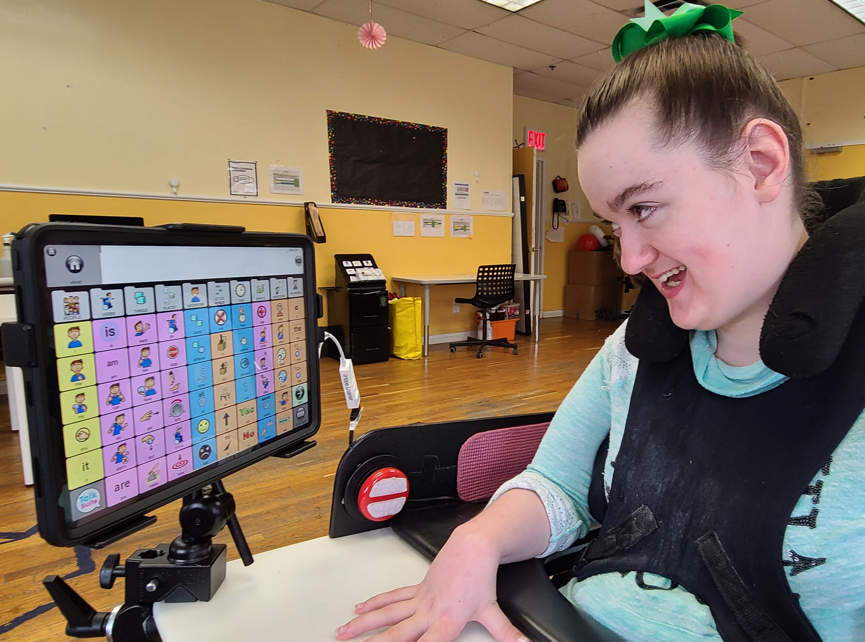
Background
AAC: Augmentative and Alternative Communication
A way for people to communicate other than verbal speech
Partial or non-verbal disabilities
developmental delays
apraxia & dyspraxia
cerebral palsy
autism spectrum disorders
traumatic brain injury
stroke
cancer
degenerative diseases: Alzheimer’s disease, ALS, muscular dystrophy, Parkinson’s disease, Huntington’s disease, MS

Slide 3
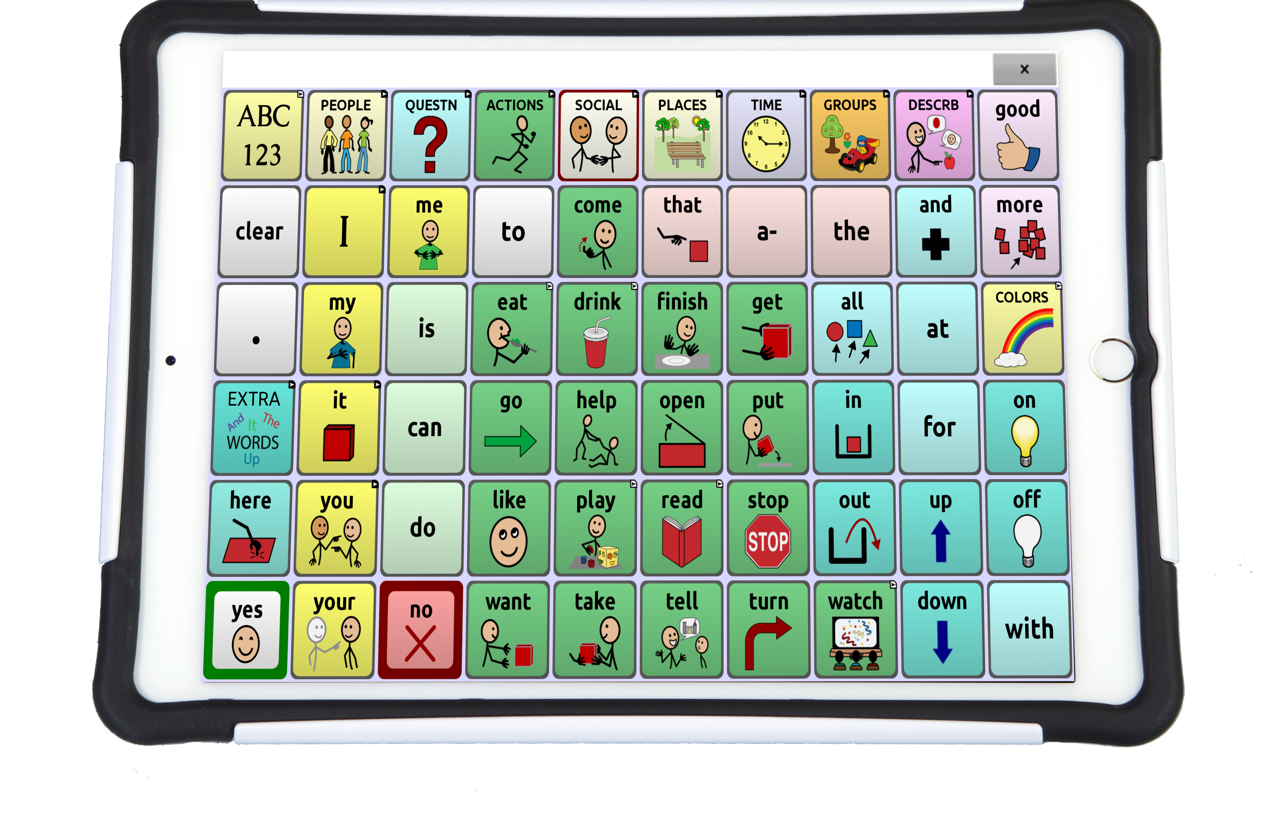
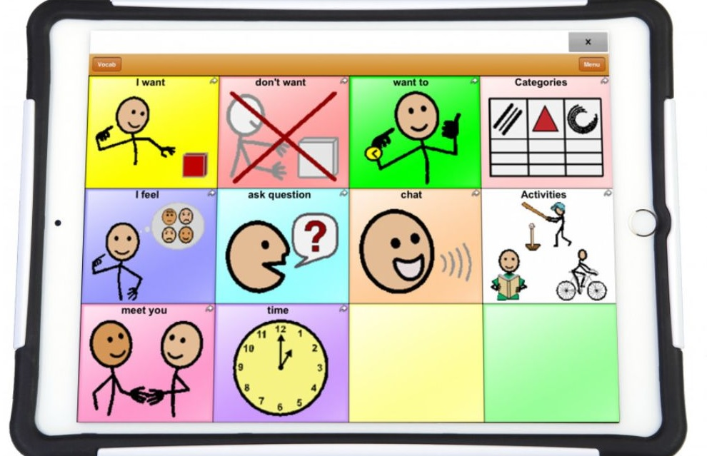
Example
TouchChat
App that can be downloaded onto a device
Press buttons to build sentences
Buttons can open new pages of words
Device reads aloud as buttons are pushed
Customizable

Slide 4
Current Limitations
Not a lot of past research that includes the user in the design process
Resulting in multiple apps that are very similar in their abilities
Have not produced new and improved apps
Does not feel natural for the user or recipient
Voice does not represent the user
Have to carry device around
Frustration in difficulty to learn and use
Often results in abandonment
Expensive
Insurance can cover fees
Language barriers

Slide 5
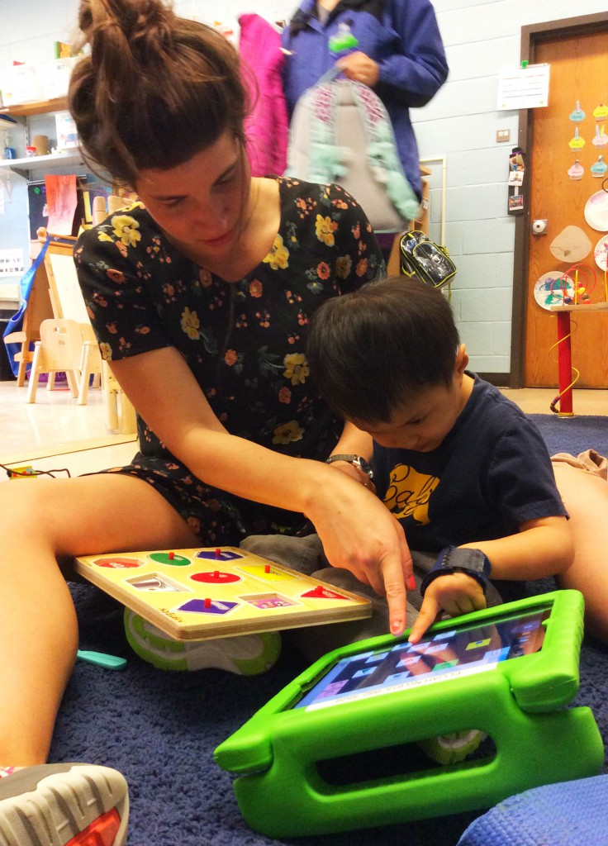
Creating a user-centered Design
User-Centered Design: focus on the user and their needs throughout the design process
Involve the users in the process
Know your users
Primary user
Design for multiple different types of disabilities
Secondary users
Parent or Guardian
Speech Language Pathologist
Other teachers, helpers, friends, family

Slide 6
4 Articles on user-centered research and design

Slide 7
Who Are You Asking?: Qualitative Methods for Involving AAC Users as Primary Research Participants
Erin Beneteau, University of Washington
“When designing technologies specifically for AAC users, AAC participants should be at the forefront of the research design and development process.”
Most past HCI research exclude AAC users in studies due to the idea of them not being able to communicate easily
Literature review from both HCI and therapeutic AAC research fields to discuss different methods used in research
Use results to guide HCI researchers on how to innovate and include AAC users as their main participants
Design opportunities
Qualitative methods
Notes:
Researchers with little exposure of working with disabled participants, and in particular, with people who use AAC devices, may feel unsure of the best practices for including AAC users in their research, even when AAC users fit the researcher’s inclusion criteria. Therefore, researchers may not include AAC users as research participants as frequently as participants who are able to communicate verbally.

Slide 8
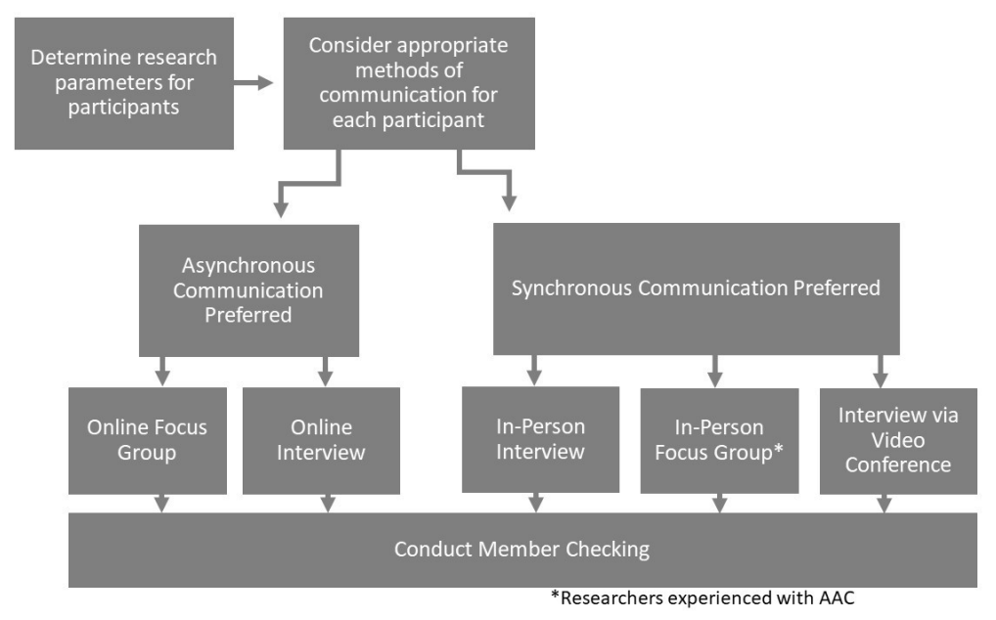
Who Are You Asking?: Qualitative Methods for Involving AAC Users as Primary Research Participants
Erin Beneteau, University of Washington
Suggestions for HCI Researchers
Use a variety of qualitative research methods to accommodate for different participants abilities
Being more flexible is better for the participants which results in better data
Interviews, focus groups, surveys, staggering questions, taking breaks
Allow a mediator or extra communicator – someone the user is familiar with is more successful
Asynchronous vs Synchronous
Notes:
Asynchronous - When conducting research utilizing asynchronous communication, the researcher will need to use accessible communication tools which AAC users are able to easily engage with. A challenge with asynchronous communication is ensuring participants are able to access the technology platform chosen;w232 researchers might need to consider multiple forms of technology for the same study in order for all participants to be able to participate. The benefits of using asynchronous communication include the ability for participants to respond at their own pace, which could provide more thorough and detailed responses.
Synchronous – Can be in person or online through call or zoom; creating the same technology challenge as asynchronous. With this method, Researchers need to consider the potential need of extra time for participant responses, as well as possible needs for breaks due to fatigue.

Slide 9
Designing Clinical AAC Tablet Applications with Adults who have Mild Intellectual Disabilities
(Gibson et al., 2020)
Study on communication between AAC users and General Practitioners
Communication is a significant barrier to accessing effective health services for people with Intellectual Disabilities
Medical professionals often find it difficult to adjust their consultation styles to cater to the complex needs of patients with Intellectual Disabilities and are unable to invest the time required to increase their knowledge in this area.
Digital technologies therefore become an important resource for supporting effective communication between GPs and the ID population

Slide 10
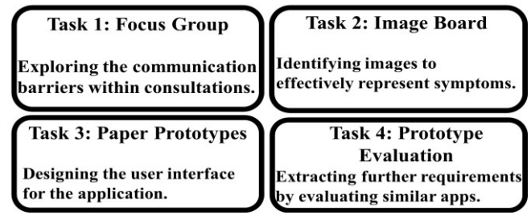
Designing Clinical AAC Tablet Applications with Adults who have Mild Intellectual Disabilities
(Gibson et al., 2020)
Population: n=10 participants with mild ID
Task 1
Focus groups
Open ended surveys to learn about current experience with care givers
Task 2
Image Boards
Sort images into groups that clearly display symptoms or are more obscure
What images can participants recognize and understand
Task 3
Paper Prototype
Participants can show how they prefer tablets and apps should function
Task 4
Prototype Evaluation
See what users require that are not seen in task 3
Practice selecting symptoms
Uncertainty of images was noted
Asked what was liked/disliked

Slide 11
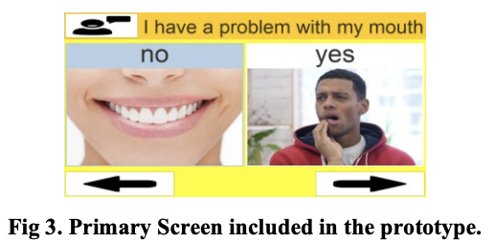
Designing Clinical AAC Tablet Applications with Adults who have Mild Intellectual Disabilities
(Gibson et al., 2020)
Suggestions made by Participants
Provide a building block of symptoms in the initial consultation
Help patients with limited verbal skills
Can point images with limited conversation
Send in symptoms ahead of time to avoid the consultation
Overcome communication barriers
Avoid going in person if possible
Questionnaire only includes primary symptoms that are relevant
Accommodate for short attention spans
Can build on symptoms later
Notes:
- Clear images can support people with ID in identifying the most appropriate service to meet their medical needs
- the participants believed that the app could assist them in being treated in a timely manner

Slide 12
User-Centered Design and Augmentative and Alternative Communication Apps for Children With Autism Spectrum Disorders
Lubas, M., Mitchell, J., & De Leo, G.
Outlines how the user-centered design process could be used in the development of AAC apps for children with autism
Past studies have been limited to single subject designs or specific situational scenarios which don’t directly to real-world scenarios
Overtime there have been an increase in the number of communication apps available but still a lack of attention in the process of app development
Need to improve past work, not just re-create what’s already available
Intended users should provide feedback throughout the software development process. If the proposed users (such as nonverbal users) are unable to participate in the design process, parents or guardians can represent or speak on behalf of them
User feedback in the design process can have an impact on the user’s comfort level with the technology, attitude toward the technology, and increase their knowledge in communication
A user-centered design approach can be an important mechanism for increasing the positive outcomes of AAC apps
Notes:
Intended users should provide feedback throughout the software development process. If the proposed users (such as nonverbal users) are unable to participate in the design process, parents or guardians can represent or speak on behalf of them
Implementing user feedback throughout the software design process can have an impact on the user’s comfort level with the technology, attitude toward the technology, and ultimately influence their competency and success. A user-centered design approach can be an important mechanism for increasing the positive outcomes of AAC app use.

Slide 13
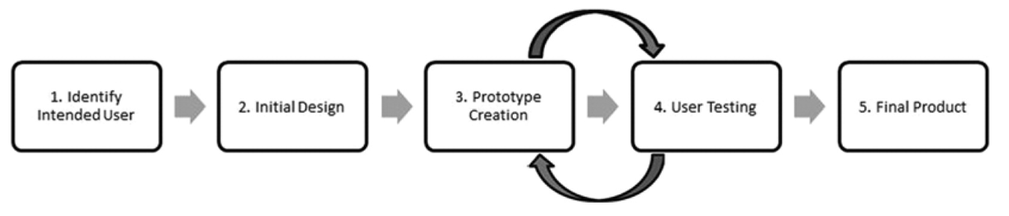
User-Centered Design and Augmentative and Alternative Communication Apps for Children With Autism Spectrum Disorders
Lubas, M., Mitchell, J., & De Leo, G.
5 step process
Involve the user in every step
Interviews, observations, surveys
Include primary users and secondary users
Use in multiple settings
Notes:
determine the intended user of the software
interviewing users or helper to inform the initial design
creation of the prototype;
a multi-stage process of user or helper prototype testing
creation of a final product.
The user-centered design process integrates feedback from the user (or proxies) at every stage in the development of the software

Slide 14
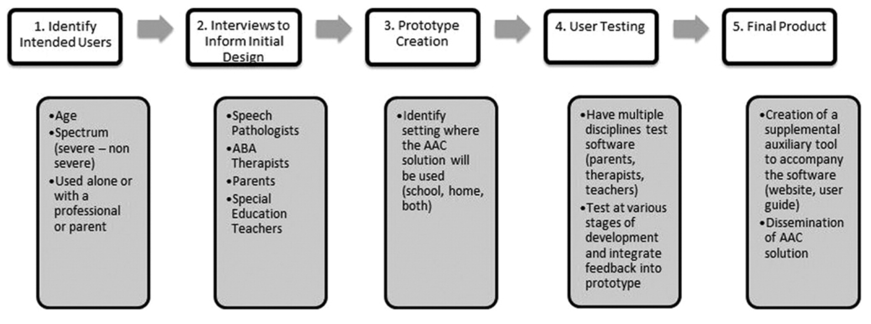
User-Centered Design Process Specific to AAC app for Children with Autism

Slide 15
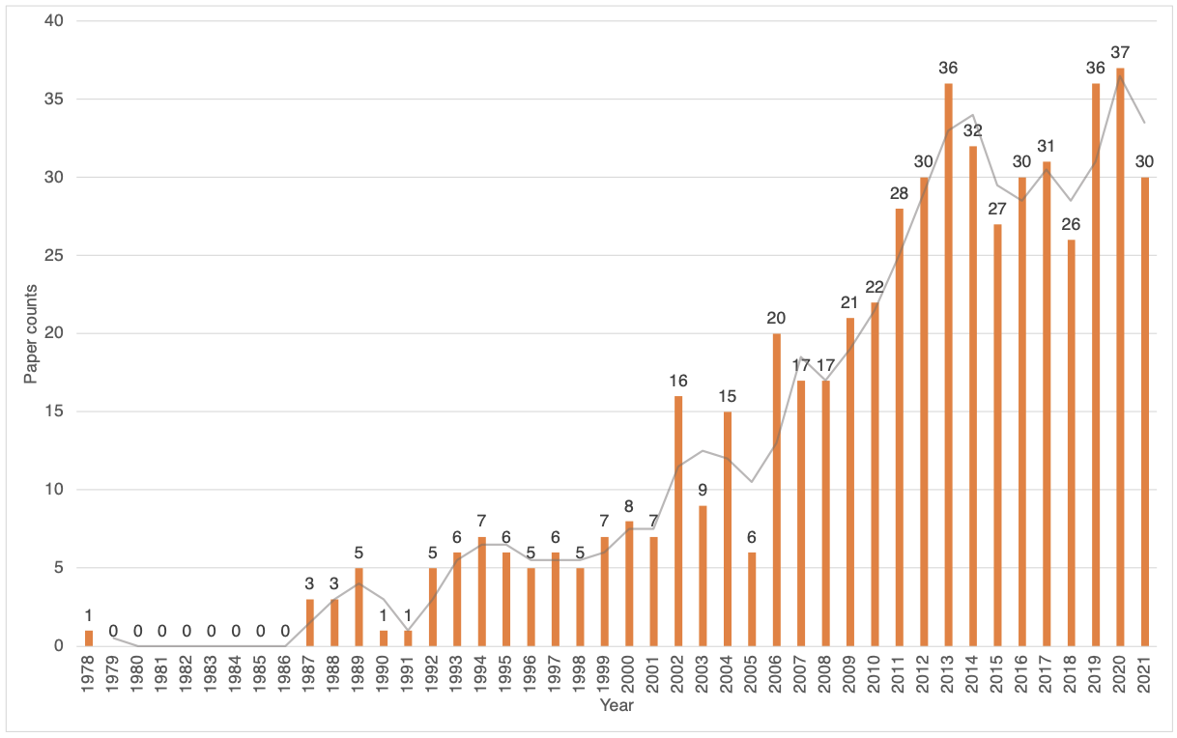
State of the Art in AAC: A Systematic Review and Taxonomy
Curtis, H., Neate, T., & Vazquez Gonzalez, C.
Frequency of AAC Papers throughout the years
Reviewed 562 articles on current AAC devices, communities used, and methods
1978-2021 (43 years)
Used coding to analyze each article
Suggest future methods and ideas for new research on the AAC design process

Slide 16
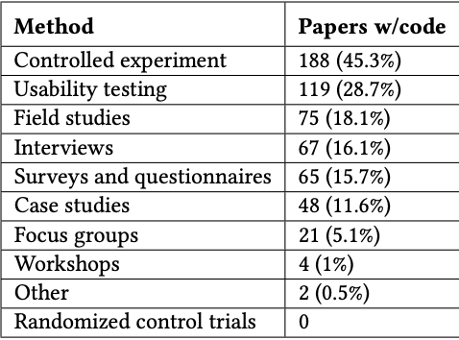
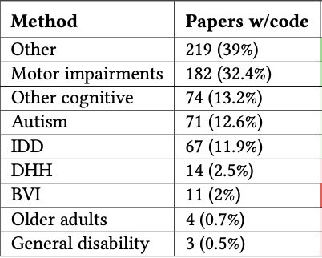
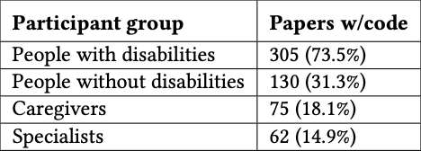
State of the Art in AAC: A Systematic Review and Taxonomy
Curtis, H., Neate, T., & Vazquez Gonzalez, C.

Slide 17
State of the Art in AAC: A Systematic Review and Taxonomy
Curtis, H., Neate, T., & Vazquez Gonzalez, C.
Suggestions for Design Process
Be sure to test the product in the environment its being used
Use actual primary AAC users in the design process
Also include caregivers, SLP’s, etc.
Notes:
It is hard to recruit, engage in interviews, participatory design, usability testing, and workshops with users that struggle to communicate independently. But HCI Researchers need to actively strive to include end users within the design and development process of AAC. In the past, Researchers have not received enough feedback from users during the development process so future research should build on their participants because user designed high-tech AAC solutions could result in better outcomes and more long-term adoption

Slide 18
Conclusion
User-Centered design process is a cycle of continuing to create prototypes, test, and fix features over and over
Ideas for Future Designs
AI to predict the next words
Video and animations
Useful for users where text-based interfaces are challenging
Be very customizable
Each user varies in needs to apps and devices need to be able to be adjusted for multiple users
Any other ideas?

Slide 19
References
Beneteau, E. (2020). Who Are You Asking?: Qualitative Methods for Involving AAC Users as Primary Research Participants. Proceedings of the 2020 CHI Conference on Human Factors in Computing Systems, 1–13. https://doi.org/10.1145/3313831.3376883
Curtis, H., Neate, T., & Vazquez Gonzalez, C. (2022). State of the Art in AAC: A Systematic Review and Taxonomy. Proceedings of the 24th International ACM SIGACCESS Conference on Computers and Accessibility. https://doi.org/10.1145/3517428.3544810
Gibson, R. C., Dunlop, M. D., Bouamrane, M.-M., & Nayar, R. (2020). Designing Clinical AAC Tablet Applications with Adults who have Mild Intellectual Disabilities. Proceedings of the 2020 CHI Conference on Human Factors in Computing Systems, 1–13. https://doi.org/10.1145/3313831.3376159
Lubas, M., Mitchell, J., & De Leo, G. (2014). User-Centered Design and Augmentative and Alternative Communication Apps for Children With Autism Spectrum Disorders. SAGE Open, 4(2). https://doi.org/10.1177/2158244014537501

